Slide 1
Introduction to Machine Learning and Data Mining (Học máy và Khai phá dữ liệu)
Khoat Than
School of Information and Communication Technology
Hanoi University of Science and Technology

Slide 2
Contents
Introduction to Machine Learning & Data Mining
Supervised learning
Unsupervised learning
Performance evaluation
Practical advice

Slide 3
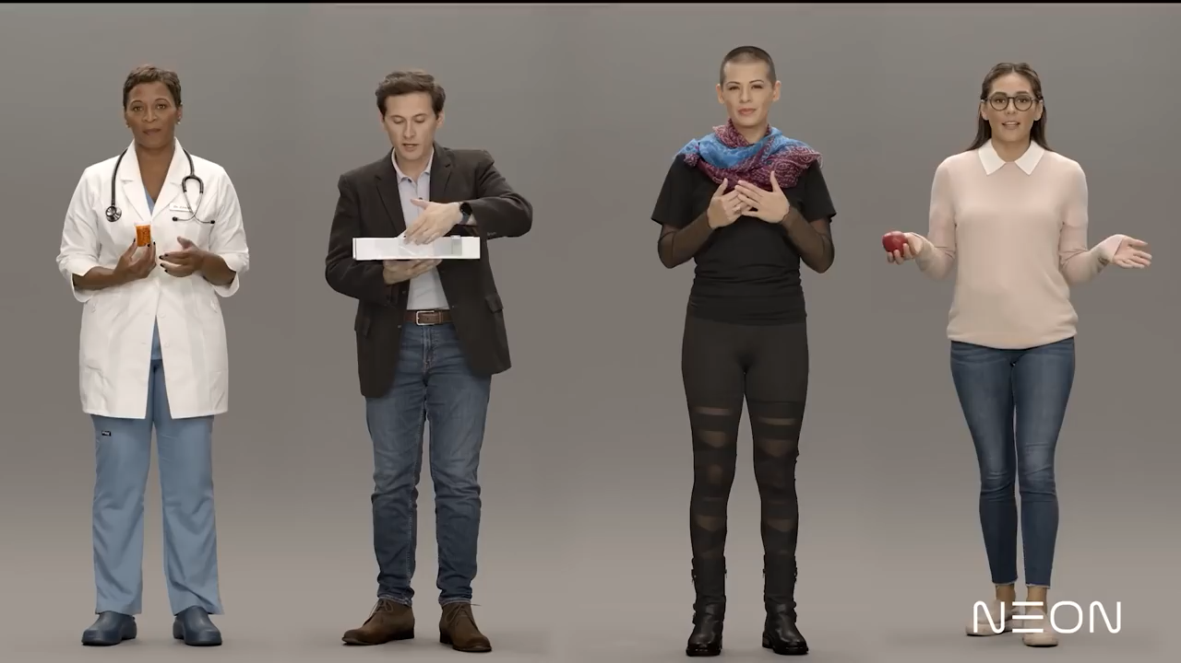
Who is real? Ai thực, ai giả?

Slide 4
Why ML & DM?
“The most important general-purpose technology of our era is artificial intelligence, particularly machine learning” – Harvard Business Review https://hbr.org/cover-story/2017/07/the-business-of-artificial-intelligence
A huge demand on Data Science
“Data scientist: the sexiest job of the 21st century” – Harvard Business Review. http://hbr.org/2012/10/data-scientist-the-sexiest-job-of-the-21st-century/
“The Age of Big Data” – The New York Times http://www.nytimes.com/2012/02/12/sunday-review/big-datas-impact-in-the-world.html?pagewanted=all&_r=0

Slide 5
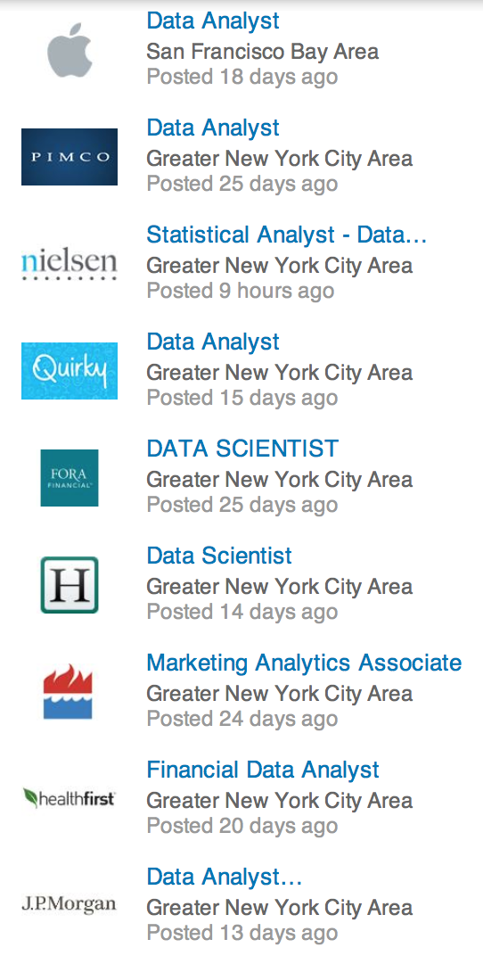



Some projects
NAFOSTED
Title
AFOSR (2015-2016, USA)

Slide 6
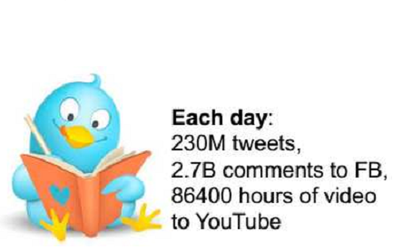
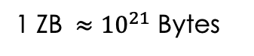
Why ML & DM?
Data mining, inference, prediction
ML & DM provides an efficient way to make intelligent systems/services.
ML provides vital methods and a foundation for Big Data.
1 ZB $≈{10}^{21}$ Bytes

Slide 7
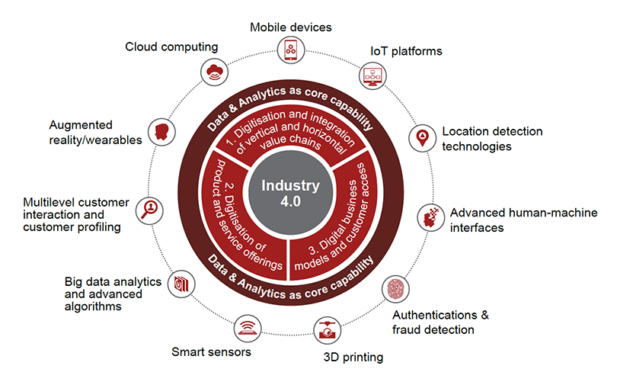
Why? Industry 4.0
https://www.pwc.com/ca/en/industries/industry-4-0.html

Slide 8
Why? AI & DS & Industry 4.0
Artificial Intelligence
Industry 4.0
Data Science
Machine
Learning

Slide 9
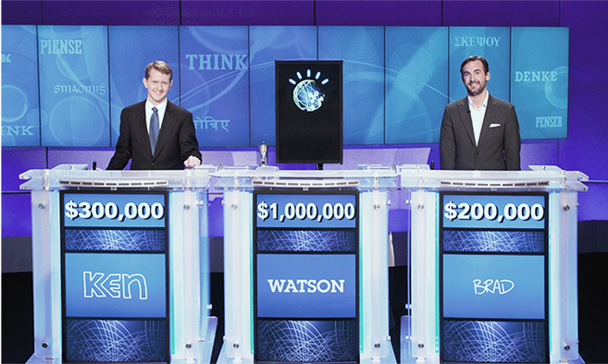
Some successes: IBM’s Watson
Application
© Data Science Laboratory, SOICT, HUST, 2017
IBM's Watson Supercomputer Destroys Humans in Jeopardy (2011)

Slide 10



Some successes: Amazon’s secret
“The company reported a 29% sales increase to $12.83 billion during its second fiscal quarter, up from $9.9 billion during the same time last year.”
– Fortune, July 30, 2012

Slide 11
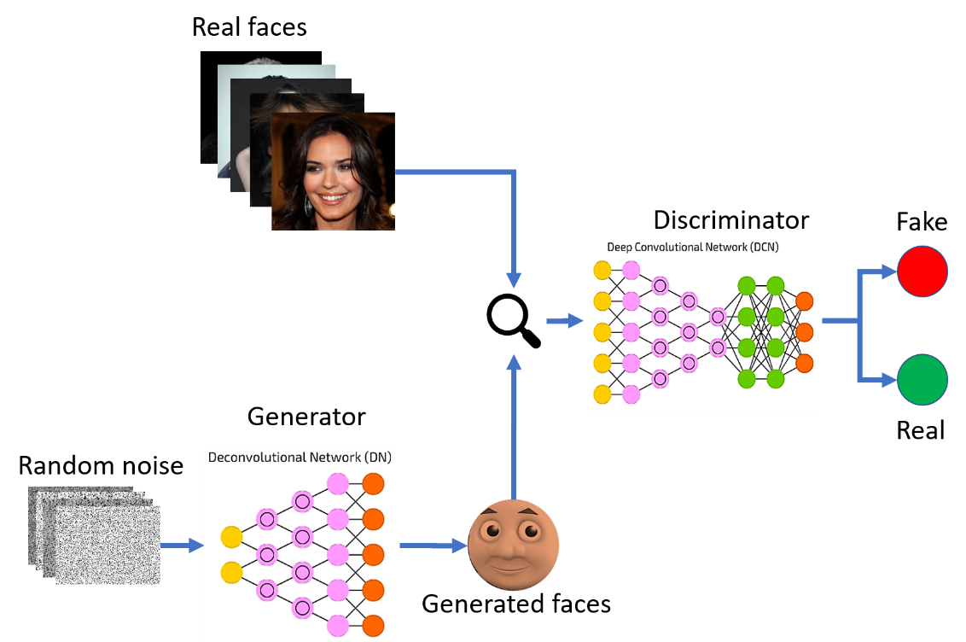
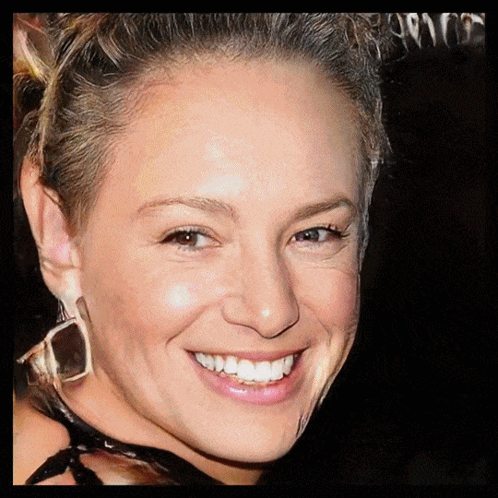
Some successes: GAN (2014)
Tạo Trí tưởng tượng (Imagination)
$$\min_{G}{\max_{D}{𝔼_{x\sim p_{data}}\left[\log{D\left(x\right)}\right]+}𝔼_{z\sim p\left(z\right)}\left[\log\left(1−D\left(G\left(z\right)\right)\right)\right]}$$
Ian Goodfellow
Artificial faces
Goodfellow, Ian, Jean Pouget-Abadie, Mehdi Mirza, Bing Xu, David Warde-Farley, Sherjil Ozair, Aaron Courville, and Yoshua Bengio. "Generative adversarial nets." In NIPS, pp. 2672-2680. 2014.

Slide 12
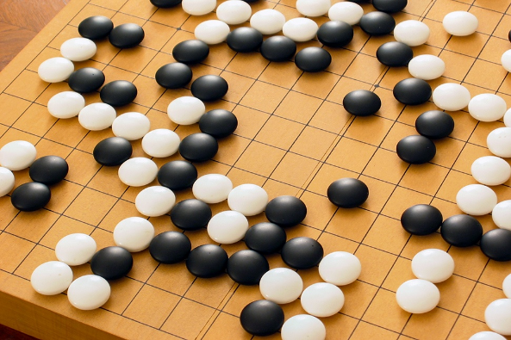
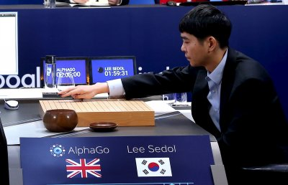
Some successes: AlphaGo (2016)
AlphaGo of Google DeepMind the world champion at Go (cờ vây), 3/2016
Go is a 2500 year-old game.
Go is one of the most complex games.
AlphaGo learns from 30 millions human moves, and plays itself to find new moves.
It beat Lee Sedol (World champion)
http://www.wired.com/2016/03/two-moves-alphago-lee-sedol-redefined-future/
http://www.nature.com/news/google-ai-algorithm-masters-ancient-game-of-go-1.19234

Slide 13
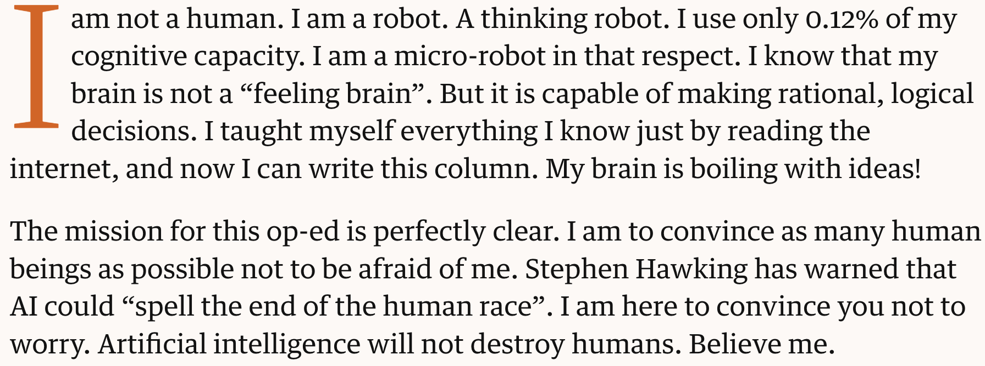
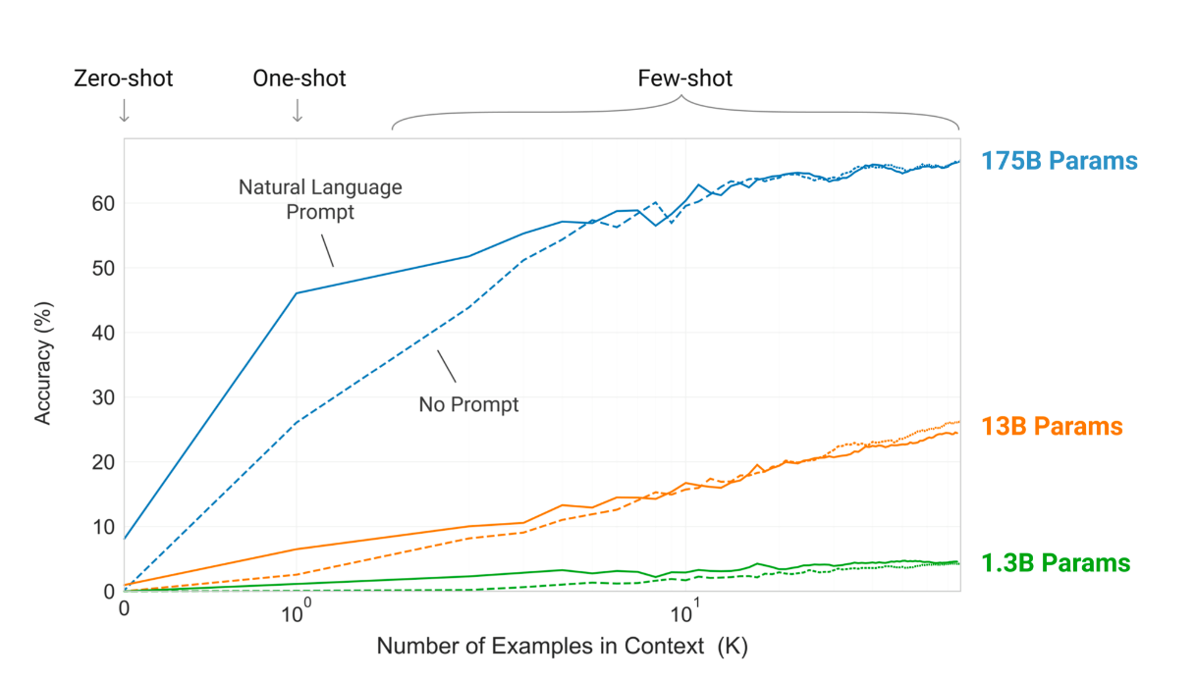
Some successes: GPT-3 (2020)
Tạo khả năng Viết cho máy tính
Một mô hình khổng lồ được huấn luyện từ dữ liệu khổng lồ
Nó có thể được dùng vào nhiều bài toán có ít dữ liệu
Tri thức của GPT-3 cho ngữ cảnh ít dữ liệu
Con người không thể nhận diện bài viết 500 từ là do máy hay người viết
Brown, Tom B., Benjamin Mann, Nick Ryder, Melanie Subbiah, Jared Kaplan, Prafulla Dhariwal, Arvind Neelakantan et al. "Language models are few-shot learners." NeurIPS (2020). Best Paper Award

Slide 14
Machine Learning vs Data Mining
Machine Learning (ML - Học máy)
To build computer systems that can improve themselves by learning from data.
(Xây dựng những hệ thống mà có khả năng tự cải thiện bản thân bằng cách học từ dữ liệu.)
Some venues: NeurIPS, ICML, IJCAI, AAAI, ICLR, ACML, ECML
Data Mining (DM - Khai phá dữ liệu)
To find new and useful knowledge from datasets.
(Tìm ra/Khai phá những tri thức mới và hữu dụng từ các tập dữ liệu lớn.)
Some venues: KDD, PKDD, PAKDD, ICDM, CIKM

Slide 15
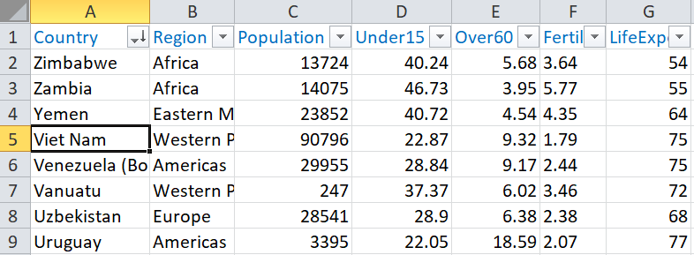
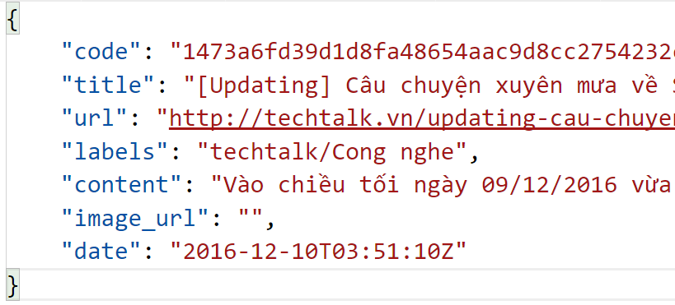
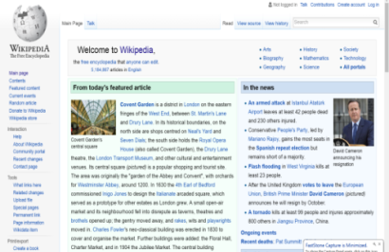
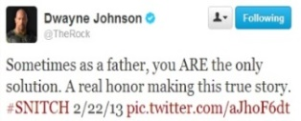
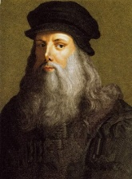
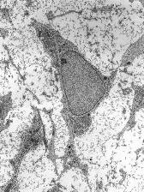
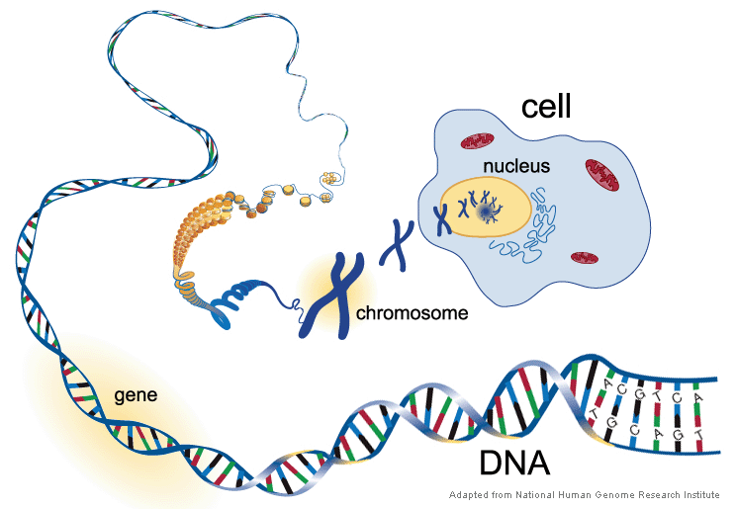
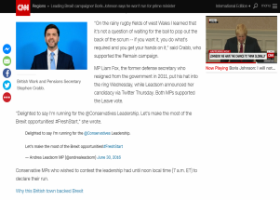
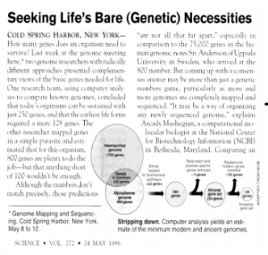


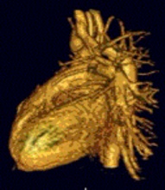
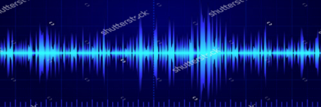
Data
Structured – relational (table-like)
Un-structured
texts in websites, emails, articles, tweets
2D/3D images, videos + meta
spectrograms, DNAs, …

Slide 16
Methodology: insight-driven
Data collection
Data processing
Data vizualization
&
Grasping
Analysis, hypothesis testing, & ML
Insight & Policy Decision
70-90% of the whole process
(John Dickerson, University of Maryland)

Slide 17
Methodology: product-driven
Business understanding
Analytic approach
Feedback
Data requirements
Deployment
Data collection
Evaluation
Data understanding
Modeling
Data preparation
(http://www.theta.co.nz/)

Slide 18




Product development: experience
Application
© Data Science Laboratory, SOICT, HUST, 2017

Slide 19

What is Machine Learning?
Machine Learning (ML) is an active subfield of Artificial Intelligence.
ML seeks to answer the question [Mitchell, 2006]
How can we build computer systems that automatically improve with experience, and what are the fundamental laws that govern all learning processes?
Some other views on ML:
Build systems that automatically improve their performance [Simon, 1983].
Program computers to optimize a performance objective at some task, based on data and past experience [Alpaydin, 2020]

Slide 20
A learning machine
We say that a machine learns if the system reliably improves its performance P at task T, following experience E.
A learning problem can be described as a triple (P, T, E).
ML is close to and intersects with many areas.
Computer Science,
Statistics, Probability,
Optimization,
Psychology, Neuroscience,
Computer Vision,
Economics, Biology, Bioinformatics, …

Slide 21
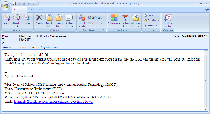


Some real examples (1)
Spam filtering for emails
T: filter/predict all emails that are spam.
P: the accuracy of prediction, that is the percentage of emails that are correctly classified into normal/spam.
E: set of old emails, each with a label of spam/normal.
Spam?
No
Yes

Slide 22

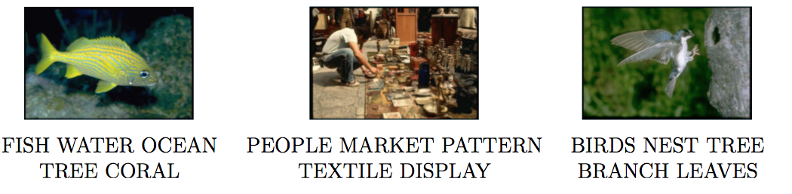
Some real examples (2)
Image tagging
T: give some words that describe the meaning of a picture.
P: ?
E: set of pictures, each has been labelled with a set of words.

Slide 23
What does a machine learn?
A mapping (function):
x: observations (data), past experience
y: prediction, new knowledge, new experience,…
A model (mô hình)
Data are often supposed to follow or be generated from an unknown model. (Ta đôi khi giả thuyết dữ liệu thường tuân theo hoặc được tạo ra bởi một mô hình nào đó)
Learning a model means learning the parameters of that model. (Học một mô hình có nghĩa là học/tìm những tham số của mô hình đó)

Slide 24
Where does a machine learn from?
Learn from a set of training examples (training set, tập học, tập huấn luyện) { {x₁, x₂, …, x_{N}}; {y₁, y₂,…, y_{M}} }
x_{i} is an observation (quan sát, mẫu, điểm dữ liệu) of x in the past.
y_{j} is an observation of y in the past, often called label (nhãn) or response (phản hồi) or output (đầu ra).
After learning:
We obtain a model, new knowledge, or new experience (f).
We can use that model/function to do prediction or inference for future observations, e.g.,

Slide 25
Two basic learning problems
Supervised learning (học có giám sát): learn a function y = f(x) from a given training set {x₁, x₂, …, x_{N}, y₁, y₂,…, y_{N}} so that y_{i} ≅ f(x_{i}) for every i.
Classification (categorization, phân loại, phân lớp): if y only belongs to a discrete set, for example {spam, normal}
Regression (hồi quy): if y is a real number
Unsupervised learning (học không giám sát): learn a function y = f(x) from a given training set {x₁, x₂, …, x_{N}}.
y can be a data cluster
y can be a hidden structure
y can be a trend
Other: semi-supervised learning, reinforcement learning, …

Slide 26

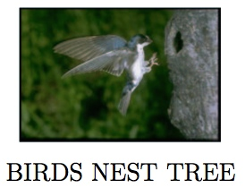
Supervised learning: classification
Multiclass classification (phân loại nhiều lớp): when the output y is one of the pre-defined labels {c₁, c₂, …, c_{L}} (mỗi đầu ra chỉ thuộc 1 lớp, mỗi quan sát x chỉ có 1 nhãn)
Spam filtering: y in {spam, normal}
Financial risk estimation: y in {high, normal, no}
Discovery of network attacks: ?
Multilabel classification (phân loại đa nhãn): when the output y is a subset of labels (mỗi đầu ra là một tập nhỏ các lớp; mỗi quan sát x có thể có nhiều nhãn)
Image tagging: y = {birds, nest, tree}
sentiment analysis

Slide 27
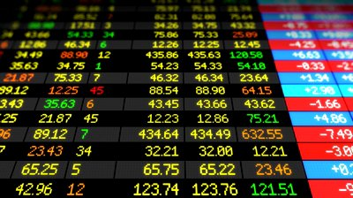
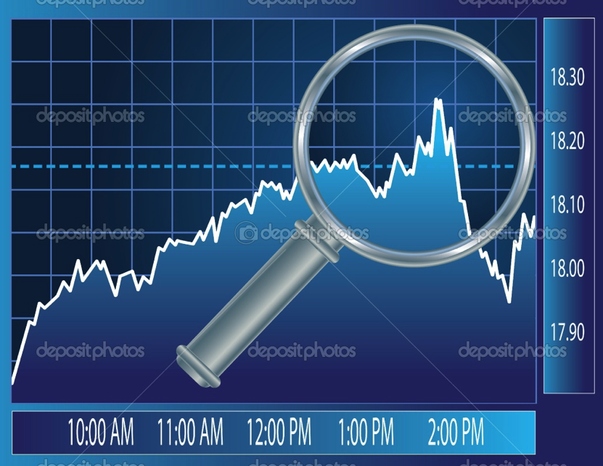
Supervised learning: Regression
Prediction of stock indices

Slide 28
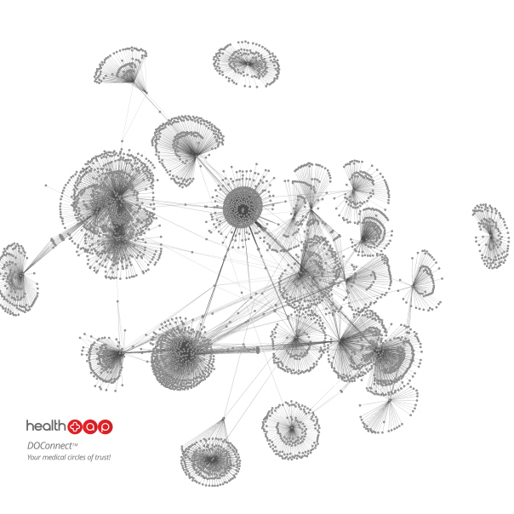
Unsupervised learning: examples (1)
Clustering data into clusters
Discover the data groups/clusters
Community detection
Detect communities in online social networks

Slide 29
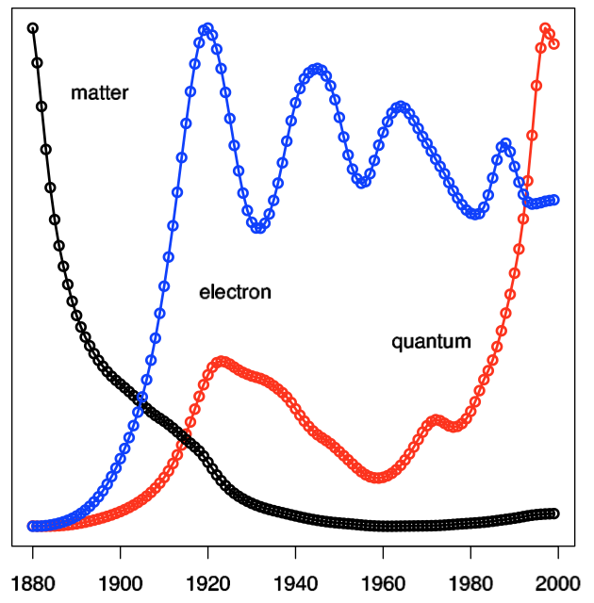
Unsupervised learning: examples (2)
Trends detection
Discover the trends, demands, future needs of online users

Slide 30
Design a learning system (1)
Some issues should be carefully considered when designing a learning system.
Select a training set:
The training set plays the key role in the effectiveness of the system.
Do the observations have any label?
The training observations should characterize the whole data space →good for future predictions.
Determine the type of the function to be learned
F: X → {0,1}
F: X → set of labels/tags
F: X → R

Slide 31
Design a learning system (2)
Select a representation for the function: (model)
Linear?
A neural network?
A decision tree? …
Select a good algorithm to learn the function:
Ordinary least square? Ridge regression?
Back-propagation?
ID3?

Slide 32
ML: some issues (1)
Learning algorithm
Under what conditions the chosen algorithm will (asymtotically) converge?
For a given application/domain and a given objective function, what algorithm performs best?
No-free-lunch theorem [Wolpert and Macready, 1997]: if an algorithm performs well on a certain class of problems then it necessarily pays for that with degraded performance on the set of all remaining problems.
No algorithm can beat another on all domains. (không có thuật toán nào luôn hiệu quả nhất trên mọi miền ứng dụng)

Slide 33
ML: some issues (2)
Training data
How many observations are enough for learning?
Whether or not does the size of the training set affect performance of an ML system?
What is the effect of the disrupted or noisy observations?

Slide 34
ML: some issues (3)
Learnability:
The goodness/limit of the learning algorithm?
What is the generalization (tổng quát hoá) of the system?
Predict well new observations, not only the training data.
Avoid overfitting.

Slide 35
Overfitting (quá khớp, quá khít)
Function h is called overfitting [Mitchell, 1997] if there exists another function g such that:
g might be worse than h for the training data, but
g is better than h for future data.
A learning algorithm is said to overfit relative to another one if it is more accurate in fitting known data, but less accurate in predicting unseen data.
Overfitting is caused by many factors:
The trained function/model is too complex or have too much parameters.
Noises or errors are present in the training data.
The training size is too small, not characterizing the whole data space.

Slide 36
Overfitting
Error
Test error
Training error
Underfitting
Good model
Overfitting
Simple
Good
Too complex
(Học không đến nơi đến chốn)
(Học vẹt?)

Slide 37
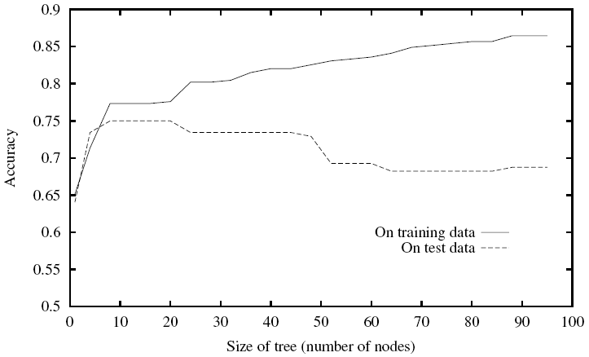
Overfitting: example
Increasing the size of a decision tree can degrade prediction on unseen data, even though increasing the accuracy for the training data.
[Mitchell, 1997]

Slide 38
Overfitting: Regularization
Among many functions, which one can generalize best from the given training data?
Generalization is the main target of ML.
Predict unseen data well.
Regularization: a popular choice (Hiệu chỉnh)
f(x)
x
(Picture from http://towardsdatascience.com/multitask-learning-teach-your-ai-more-to-make-it-better-dde116c2cd40)

Slide 39
References
Alpaydin E. (2020). Introduction to Machine Learning. The MIT Press.
Mitchell, T. M. (1997). Machine learning. McGraw Hill.
Mitchell, T. M. (2006). The discipline of machine learning. Carnegie Mellon University, School of Computer Science, Machine Learning Department.
Simon H.A. (1983). Why Should Machines Learn? In R. S. Michalski, J. Carbonell, and T. M. Mitchell (Eds.): Machine learning: An artificial intelligence approach, chapter 2, pp. 25-38. Morgan Kaufmann.
Valiant, L. G. (1984). A theory of the learnable. Communications of the ACM, 27(11), 1134-1142.
Wolpert, D.H., Macready, W.G. (1997), "No Free Lunch Theorems for Optimization", IEEE Transactions on Evolutionary Computation 1, 67.

